Slide 1


Semiconductor-Nanowire-Based Superconducting Qubit
(以奈米線半導體為基底之超導量子位元)
報告者 : 林威辰
指導教授: 邱奎霖 教授
Physical Review Letters

Slide 2
Outline
Introduction
The types of Qubit
What is nanowire?

Slide 3
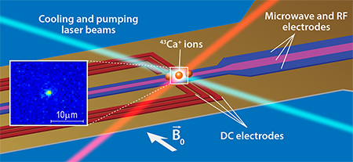
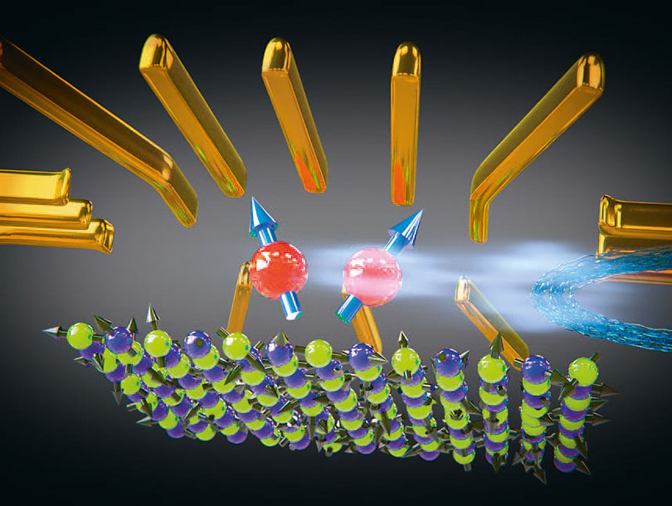
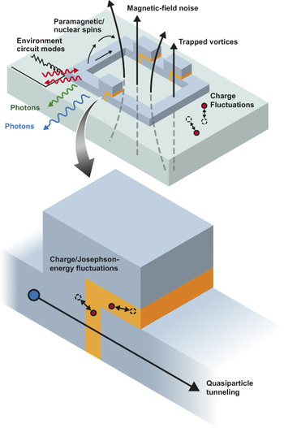
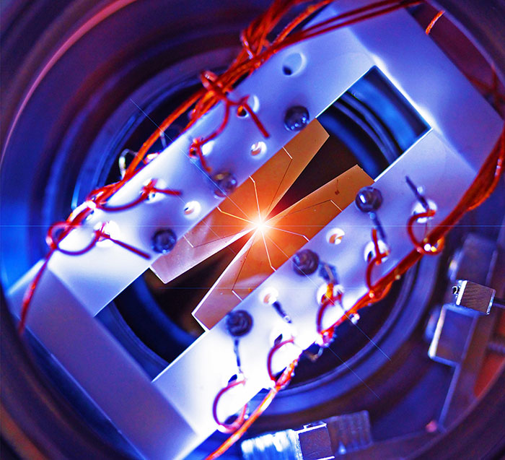
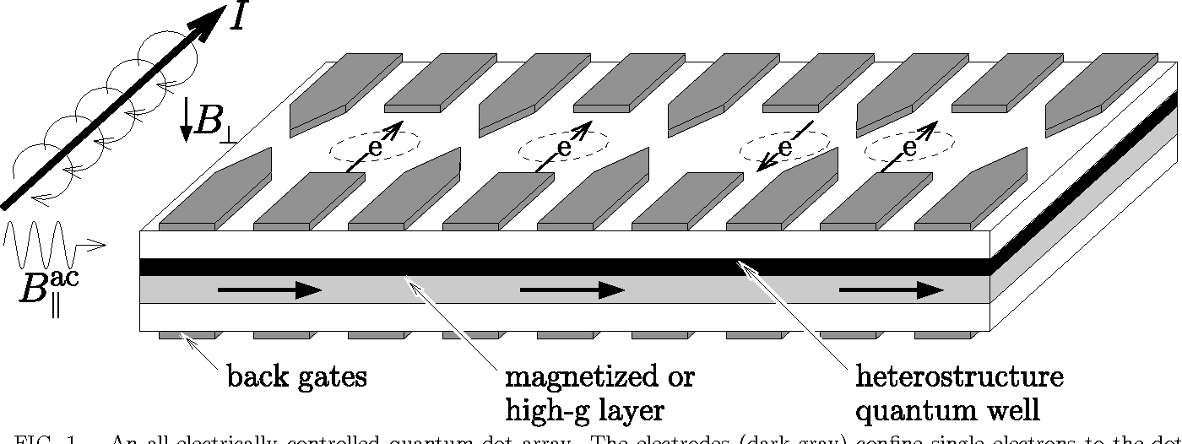
Types of Qubit
Trapped Ion
Quantum Dot
Superconducting Qubit

Slide 4
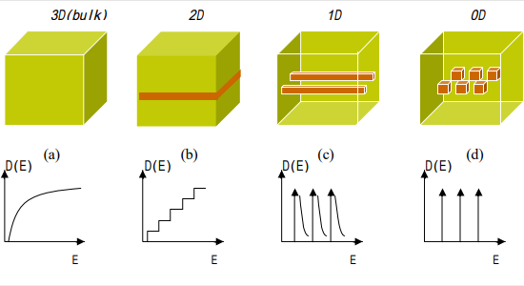


Types of Nanostructure
$$N\left(E\right)=\frac{2V}{4π^{2}}{(\frac{2m}{h^{2}})}^{\frac{3}{2}}E^{\frac{1}{2}}$$
$$N=\int_{0}^{∞}{f\left(E\right)N\left(E\right)dE}$$

Slide 5
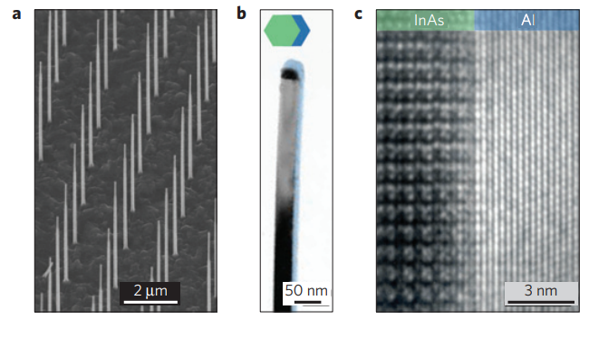
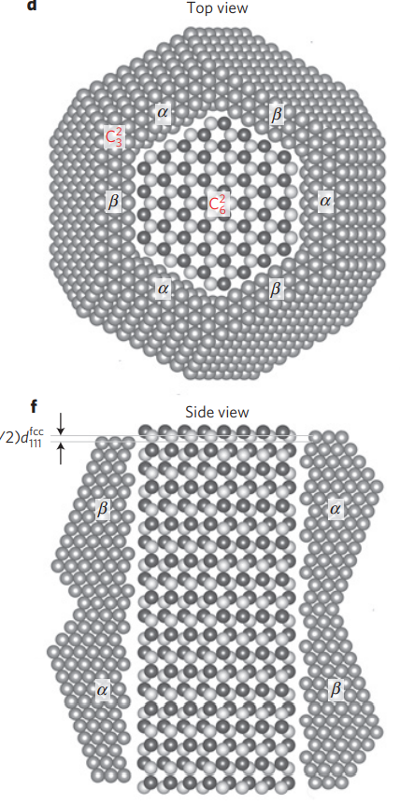
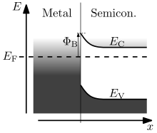
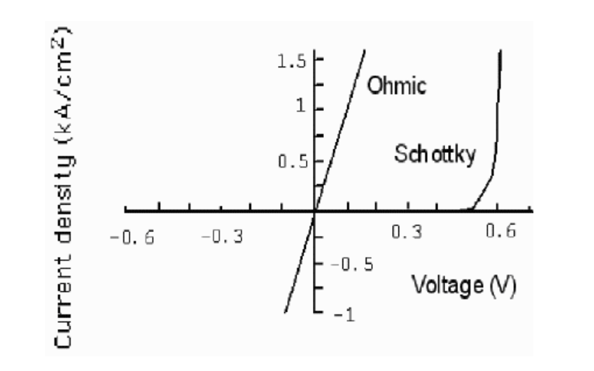
InAs/Al nanowire
Al is compatible with fabrication and nice superconductive ability
Schottkey barrier-free interface
Easy to be single crystal
InAs has large g factor about 10
P. Krogstrup, et al, “Epitaxy of semiconductor–superconductor nanowires”, Nature Materials

Slide 6
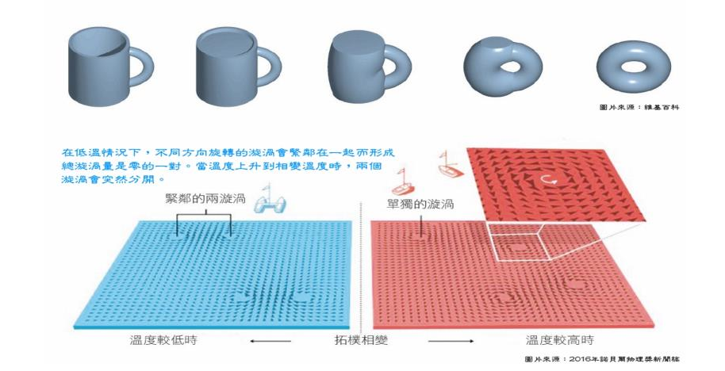

Slide 7
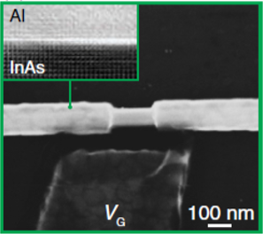
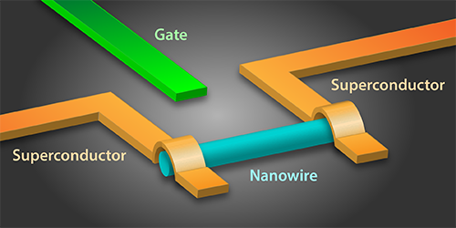
Nanowire
Gate
Gate

Slide 9
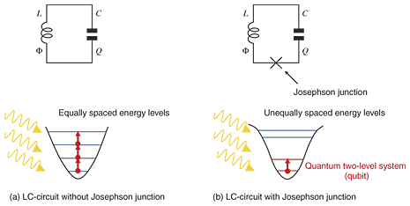
Superconducting Qubit – Josephson Junction
zz
Insulator
Non
Supercouductive
Metal
Superconductor
Superconductor
Superconductor
Superconductor
d
d
Produce an anharmonic energy level
Manipulated with radio frequency

Slide 10
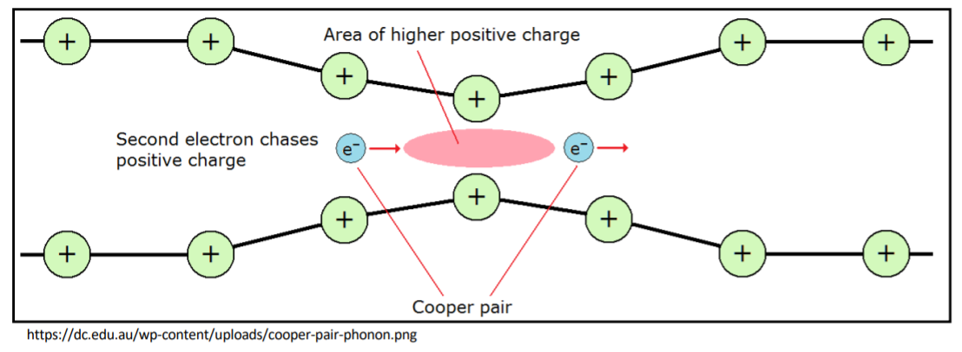
Superconducting Qubit – Cooper pair
電聲子交互作用

Slide 11
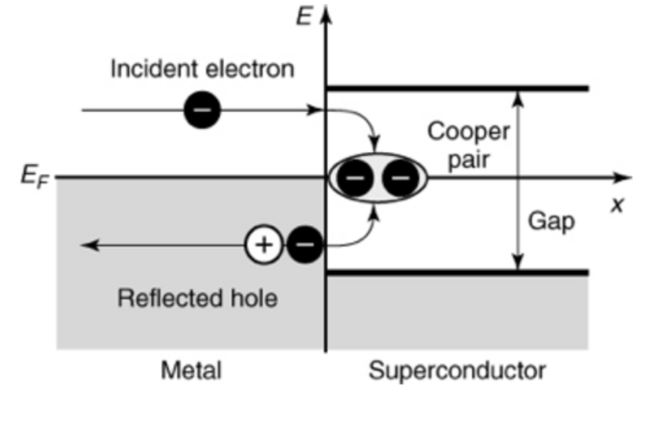
Superconducting Qubit – Andreev Reflection
-
-
-
-
Superconducting Band gap

Slide 12
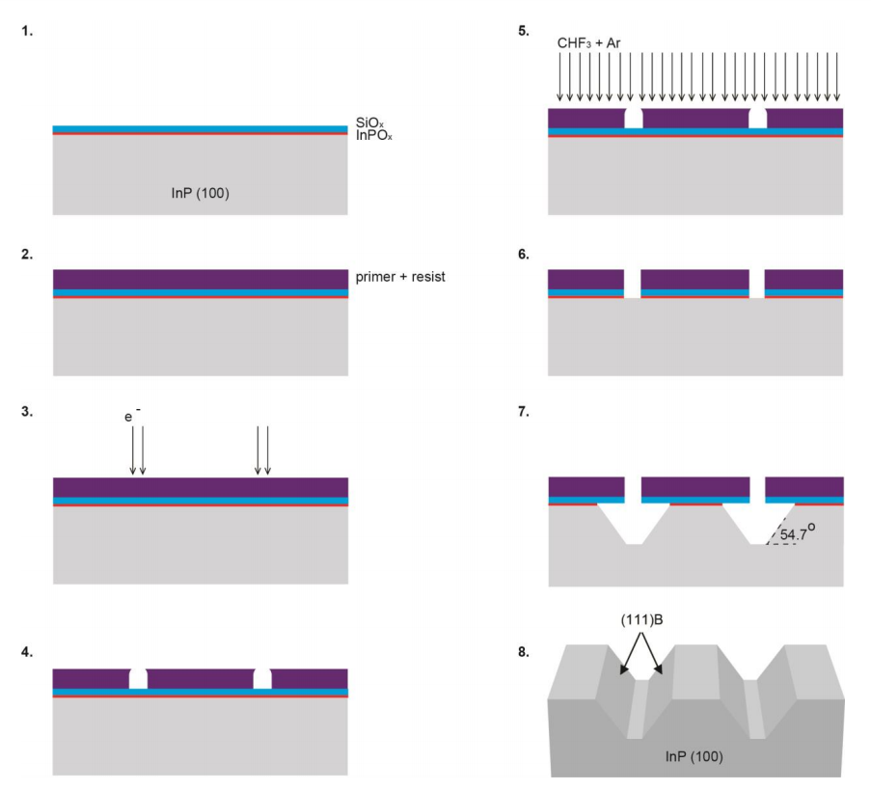
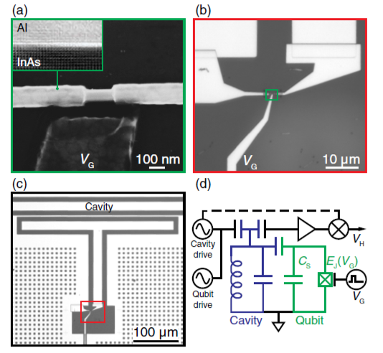
TEM/OM of Device
Sasa Gazibegovic, et al

Slide 13
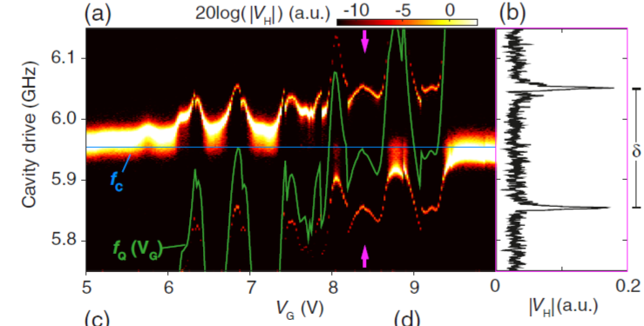






Superconducting Qubit – Readout
*Qubit頻率可由Vg決定
When
共振腔和超導元件產生耦合
由電導
導致
閘極電壓改變了頻率及電導
W. Chang1,2, et al, “Hard gap in epitaxial semiconductor– superconductor nanowires”, Nature

Slide 14
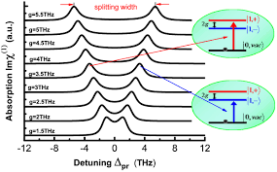
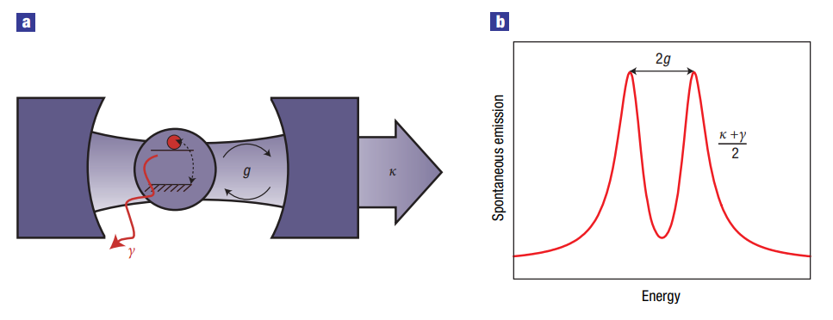
Superconducting Qubit – Vacuum Rabi Splitting
Splitting width 可得耦合強度

Slide 15
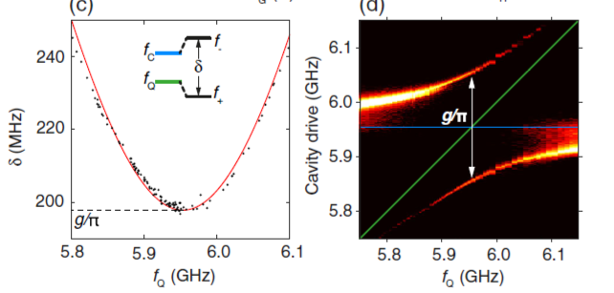
Superconducting Qubit – Coupling

Slide 16
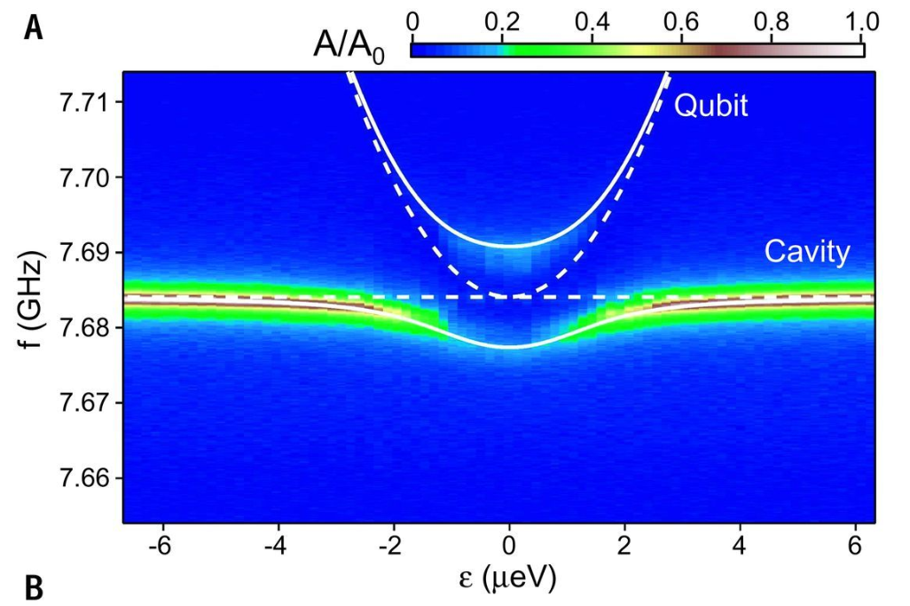
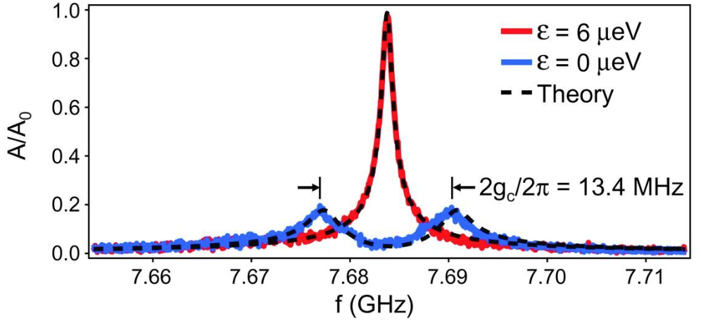
Superconducting Qubit – Coupling
Strong Coupling

Slide 17
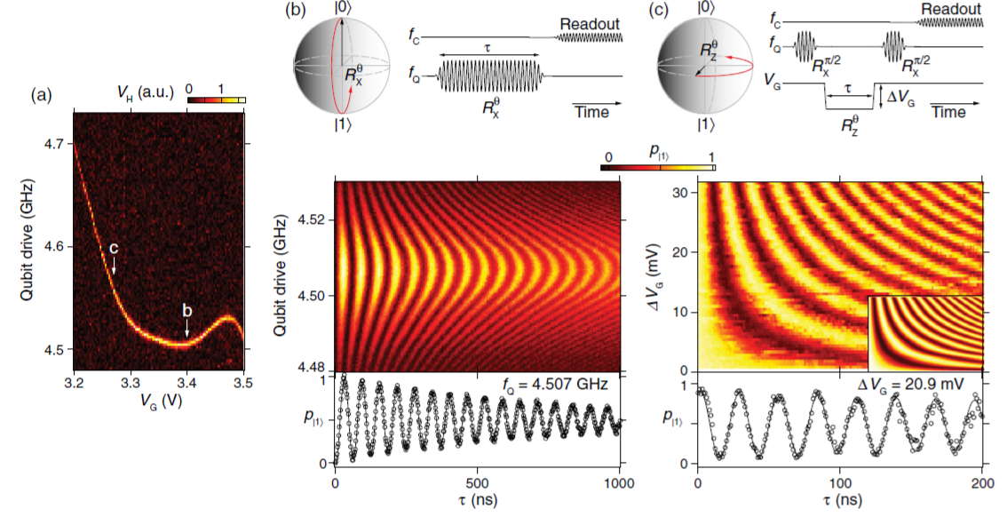
Superconducting Qubit – Measurement
Rabi oscillation

Slide 18
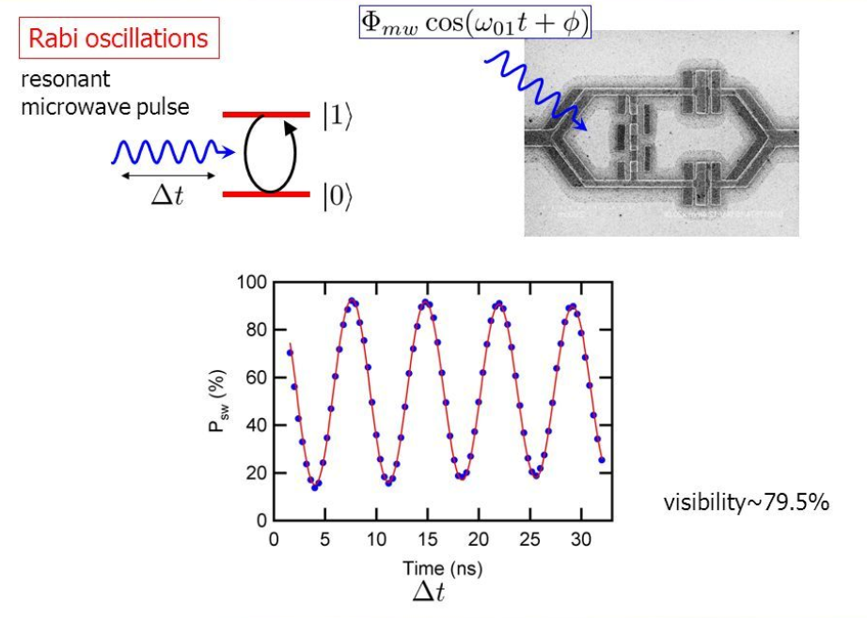
Superconducting Qubit – Rabi Oscillation

Slide 19
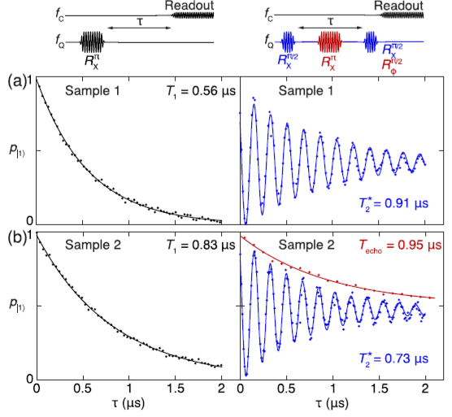
Superconducting Qubit – Measurement
Transmon before:
T1: 2~40μs
T2: 2~15μs
Future Work:
1. Remove SiO2 dielectric layer
2. Perfect Processing
3. Improving NWs interface
4. High power devices
5. Majorana bound state

